Slide 1
Lessons to be learned
Guidance for a safe return to college
v2 June 2020

Slide 2
Introduction
The CICV Forum is helping colleges consider what actions should be taken ahead of a proposed return to teaching.
The main principles have been set out by the Scottish Government and various construction groups. Adhering to these principles will keep apprentices as safe as possible.
The CICV Forum aims to help colleges and approved centres get back up and running as quickly and as safely as possible.
If these rules and procedures are followed, in line with Scottish Government guidance, we are prepared and ready to resume apprenticeship training.

Slide 3
Objective
The CICV Forum’s message is clear:
We must safeguard not only trainees within our industry, but also our wider communities and families. We all must work together to stop this virus not only for ourselves but for our loved ones.
www.cicvforum.co.uk
3

Slide 4
Overarching principles
What colleges can do
Protect the vulnerable
Ensure apprentices in a vulnerable group, i.e. with underlying health issues, are advised to follow physical distancing guidance or stay at home, with alternative attendance methods provided.
Keep contact lists updated
Ensure all contact numbers and emergency contact details for each student are up to date.
Provide staff with knowledge
Ensure all lecturers receive sufficient training to know how to spot the symptoms of the virus.
Offer correct facilities
Ensure there is suitable provision at each college for hand washing, sanitising, cleaning etc.
Police physical distancing
Ensure that procedures for physical distancing are put in place and adhered to.

Slide 6
Symptoms
Ensure no one having any of the following symptoms attends college:
High temperature
Cough
Shortness of breath
Breathing difficulties
Loss of smell or taste.
Training providers should be informed immediately if an apprentice shows any of these symptoms.
Anyone with these symptoms must self-isolate and not attend college as follows:
Living alone – stay at home for seven days from the date when your symptoms started.
Living with others – stay at home for seven days from the date
when your symptoms started. All other householders should
isolate for 14 days, starting from when your symptoms began. If other householders develop symptoms during these 14 days, they should stay at home for seven days, starting from the date when their symptoms began.
Find out more at www.nhsinform.scot

Slide 7
What is physical distancing?
Physical distancing is one part of a range of intervention measures taken to reduce the spread of COVID-19.
To do this, people are encouraged to maintain a physical distance between each other and reduce the number of times they come into contact with other people.
In order to slow the transmission rate of COVID-19, a minimum physical distance of two metres is currently recommended by Health Protection Scotland.
www.cicvforum.co.uk
7

Slide 8
Physical distancing / 1
What we can do to ensure physical distancing:
01
04
Make regular announcements to remind apprentices to follow physical distancing advice and wash their hands regularly.
Encourage the use of digital and remote transfers of coursework material.
If possible, provide additional pop-up hand washing stations or facilities. Provide soap, water, hand sanitiser and tissues and encourage apprentices to use them.
Always follow the most up-to-date physical distancing guidelines.
Use signage to direct movement into lanes in corridors and entrances.
02
05
03

Slide 9
Physical distancing / 2
What we can do to ensure physical distancing:
06
09
Regulate entry so that premises do not become overcrowded. Classes may need to be split and day release used for some students.
Use prominent signage to remind apprentices to stay at home if they have COVID-19 symptoms.
Minimise the number of lecturers per class, to reduce the chance of cross-contamination.
Encourage apprentices to bring their own food and to avoid canteens.
Keep doors open around the college to encourage a steady flow of foot traffic and leave classroom doors open for better physical distancing.
10
07
08

Slide 10
Physical distancing when carrying out tasks at a college/training centre
Physical distancing
Transmission
Plan of action
Can the task be completed by following the 2m physical distancing guidelines?
Can transmission points
be eliminated?
YES
YES
Continue
NO
YES
NO
Can the task be eliminated; or modified to achieve 2m physical distancing?
Can transmission points be cleaned before and after use?
YES
Continue
NO
NO
Are other preventative
measures possible?
YES
Continue
NO
STOP and consult college management

Slide 11
Travel to college
Physical distancing is advised when travelling in vehicles to and from college.
Suggested arrangements are as follows:
Single occupancy of vehicles is preferable
If this is not possible, sit as far apart as the vehicle allows and ventilate the vehicle by opening windows.
Avoid using public transport where possible, but if doing so:
Avoid peak travel times
A face covering MUST be worn.

Slide 12
Tools, equipment and plant
All tools and equipment should be properly sanitised as frequently as possible to prevent cross-contamination.
Where possible, ensure only one person uses the same tool, equipment and plant.
Provide cleaning materials and disinfectant so tools can be wiped down between each user.
Organise work practices to eliminate and reduce transmission points and coach college personnel on the same.

Slide 13
Toilet facilities
Restrict the number of people using toilets at any one time.
Ensure a physical distance is maintained while using the toilets.
Implement an appropriate COVID-19 hygiene regime:
Ensure visual hand washing guides are clearly visible and can be understood by all.
Enhance the cleaning regime in all toilets, particularly door handles, locks and flush handles.
Provide suitable and sufficient rubbish bins for hand towels, with regular removal and disposal.

Slide 14
Canteens and eating arrangements / 1
Where possible, apprentices and students should be advised to bring their own food and drink to college.
Break times should always be staggered to reduce congestion and maintain physical distancing.
Apprentices and students must be encouraged to wash their hands before eating.
Hand cleaning facilities or hand sanitiser should be available at the entrance and exit of any room where people eat. This should be used by all personnel when entering and leaving.

Slide 15
Canteens and eating arrangements / 2
Ensure staff, apprentices and students avoid physical contact and always follow physical distancing guidance while eating.
Where catering is provided, consider using pre-prepared and wrapped food only.
Wherever possible, payment should be taken by contactless card.
Tables should be cleaned between each use and sittings based on a rota system.

Slide 16
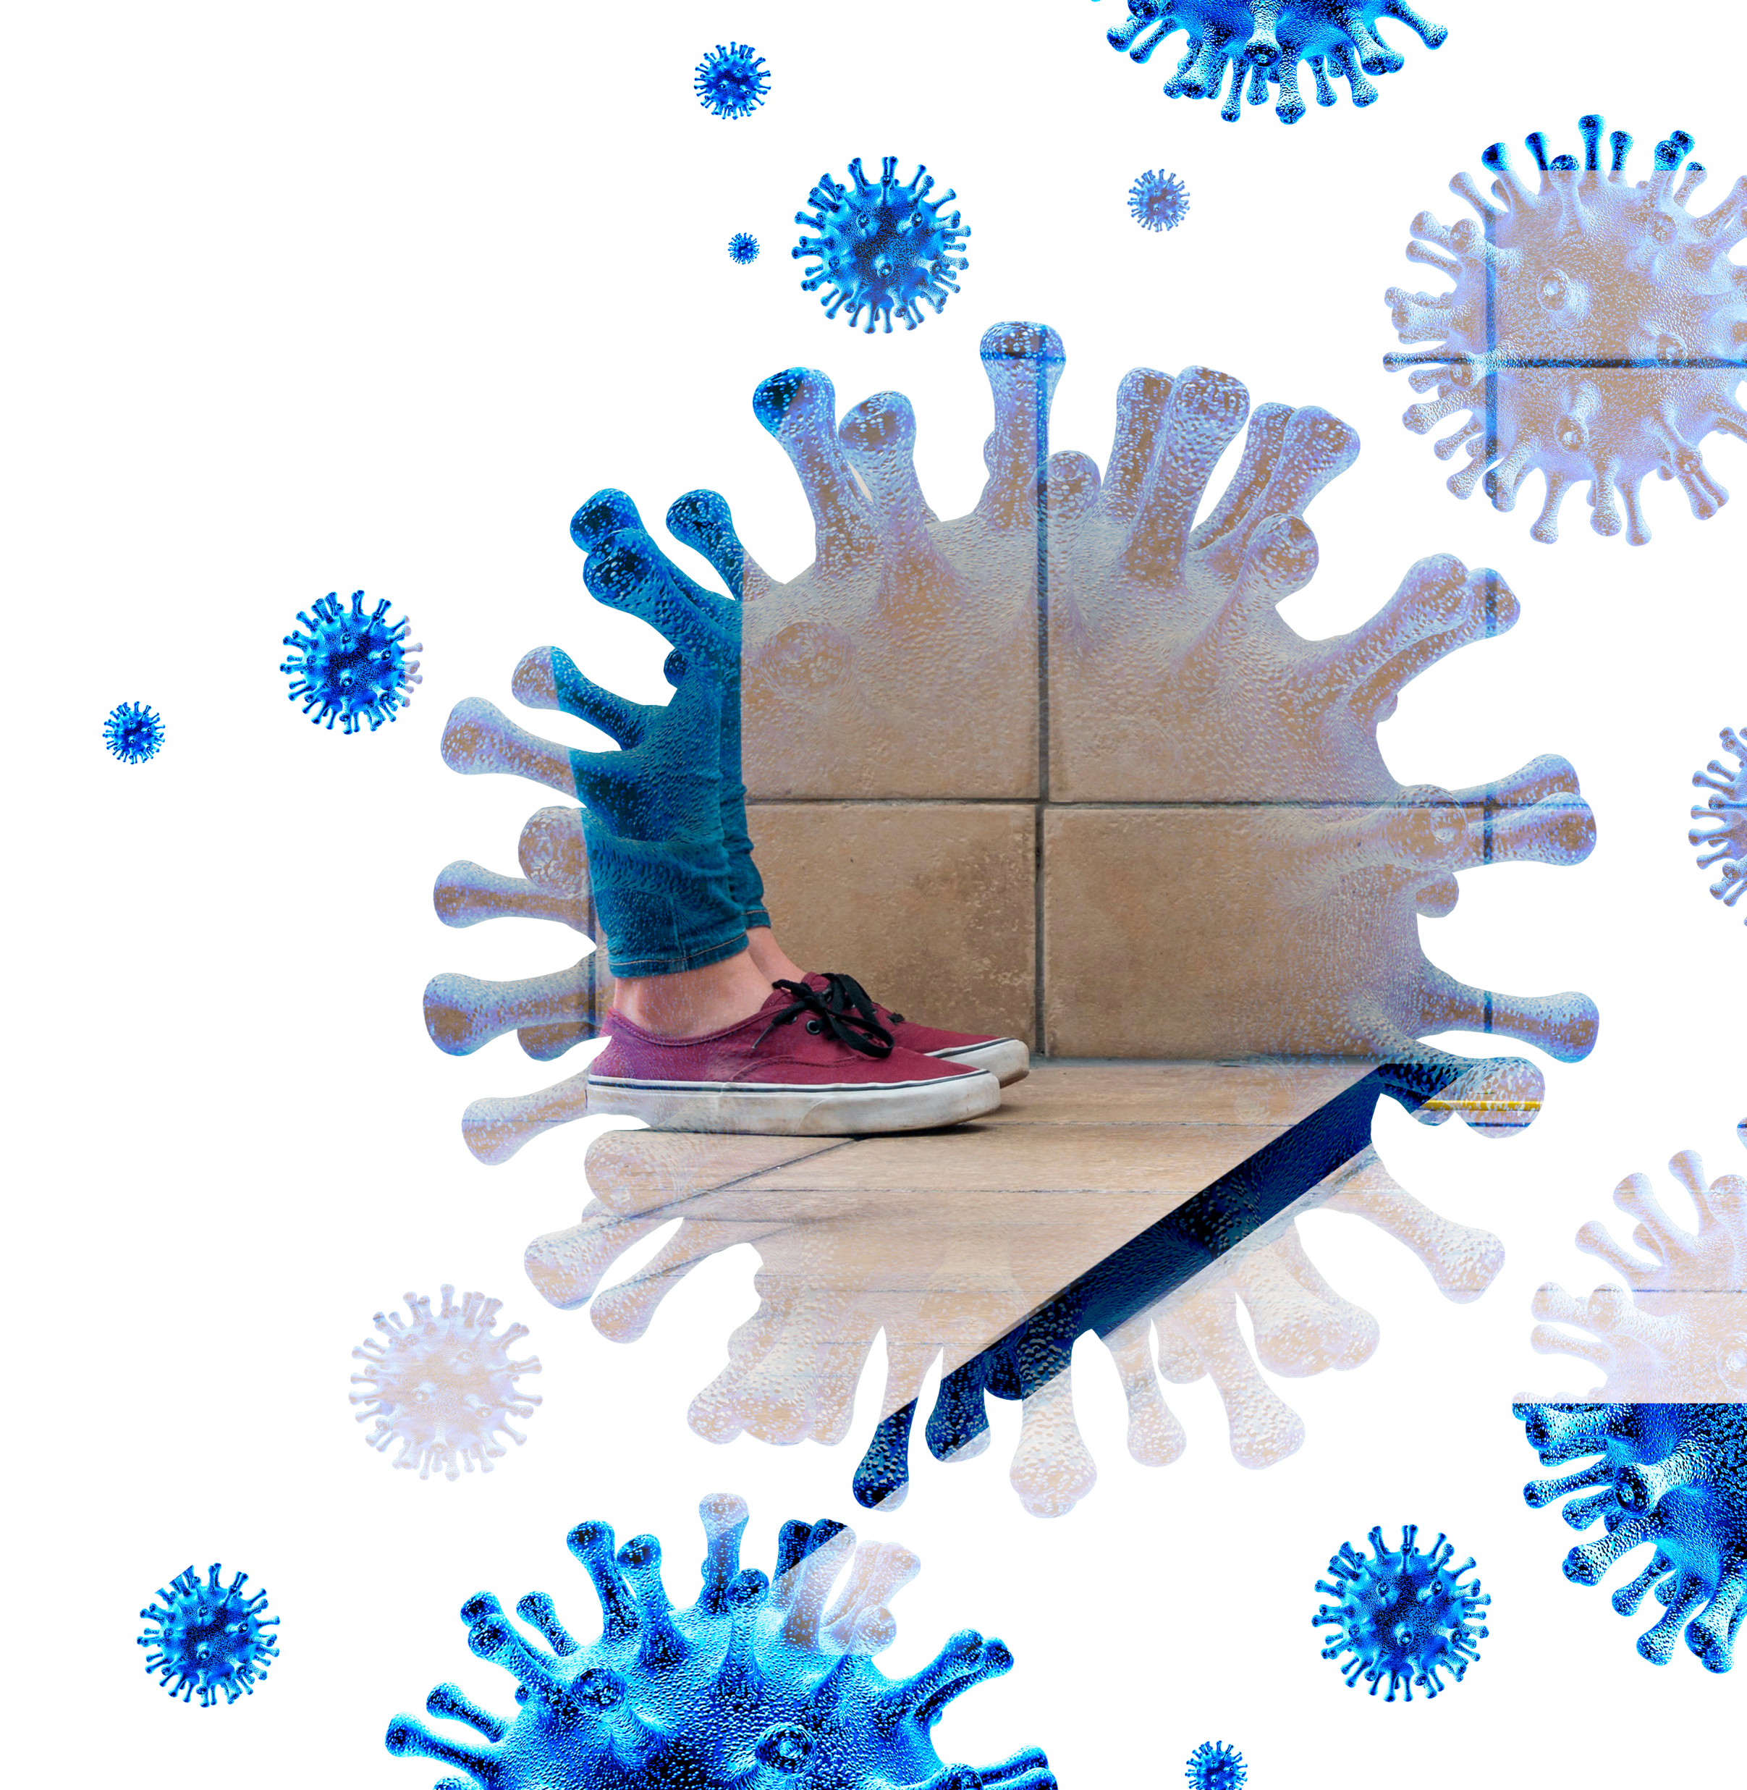
Corridors
Wherever possible, introduce a one-way system on access routes throughout the college.
Increase access points to help establish this one-way system, e.g. make it clear that there is one door in and another door out.
Mark up walkways to clearly indicate two-metre spacing.

Slide 17
First Aiders / 1
First Aid Responders should be aware that COVID-19 infects through contact with the mucous membranes, i.e. mouth, nose and eyes. It does not infect through the skin.
Therefore, the greatest element of risk for a Responder is transfer via contact with contaminated eyes, nose, mouth or hands, including contaminated gloves.
The key interventions to manage this risk are to:
Minimise hand contamination
Avoid touching your face
Clean your hands frequently with soap and water or alcohol-based hand gel.

Slide 18
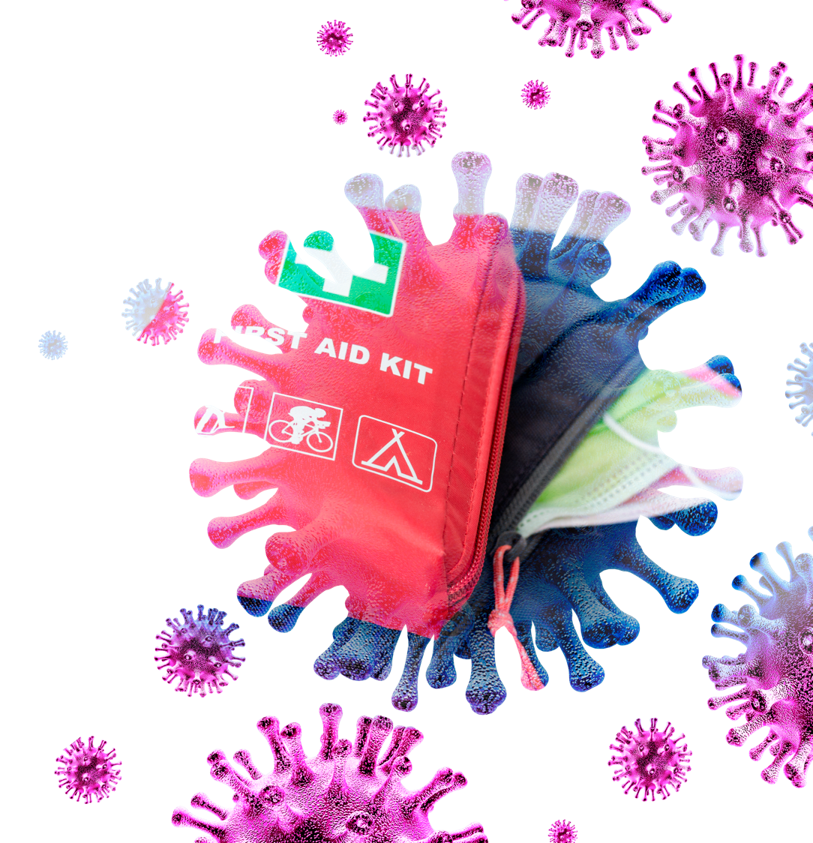
First Aiders / 2
A significant risk also comes from direct transfer transmission, i.e. droplets from sneezing or coughing landing in your eyes, nose or mouth.
This risk is managed by use of appropriate PPE, e.g. mask and eye protection.
The affected person can also be given a mask to cover their nose and mouth when coughing or sneezing.
As a Responder, try to avoid close contact with anyone who requires first aid except in unavoidable scenarios, e.g. emergency life-saving measures due to cardiac arrest, heart attack, choking or stroke.

Slide 19
First Aiders / 3
The following PPE must be available for Responders:
Disposable gloves (nitrile/latex)
FFP3 or FFP2 face masks
Disposable plastic aprons
Enclosed eye protection
Responders must ensure the mask covers the mouth and nose and is fitted correctly to create an adequate seal.
After treatment, disposable PPE and waste should be discarded appropriately and reusable PPE cleaned and disinfected thoroughly.
Wash your hands thoroughly with warm water and soap before and after using PPE.
Replenish PPE stock as appropriate and liaise with the designated person to ensure any issues are resolved quickly.

Slide 20
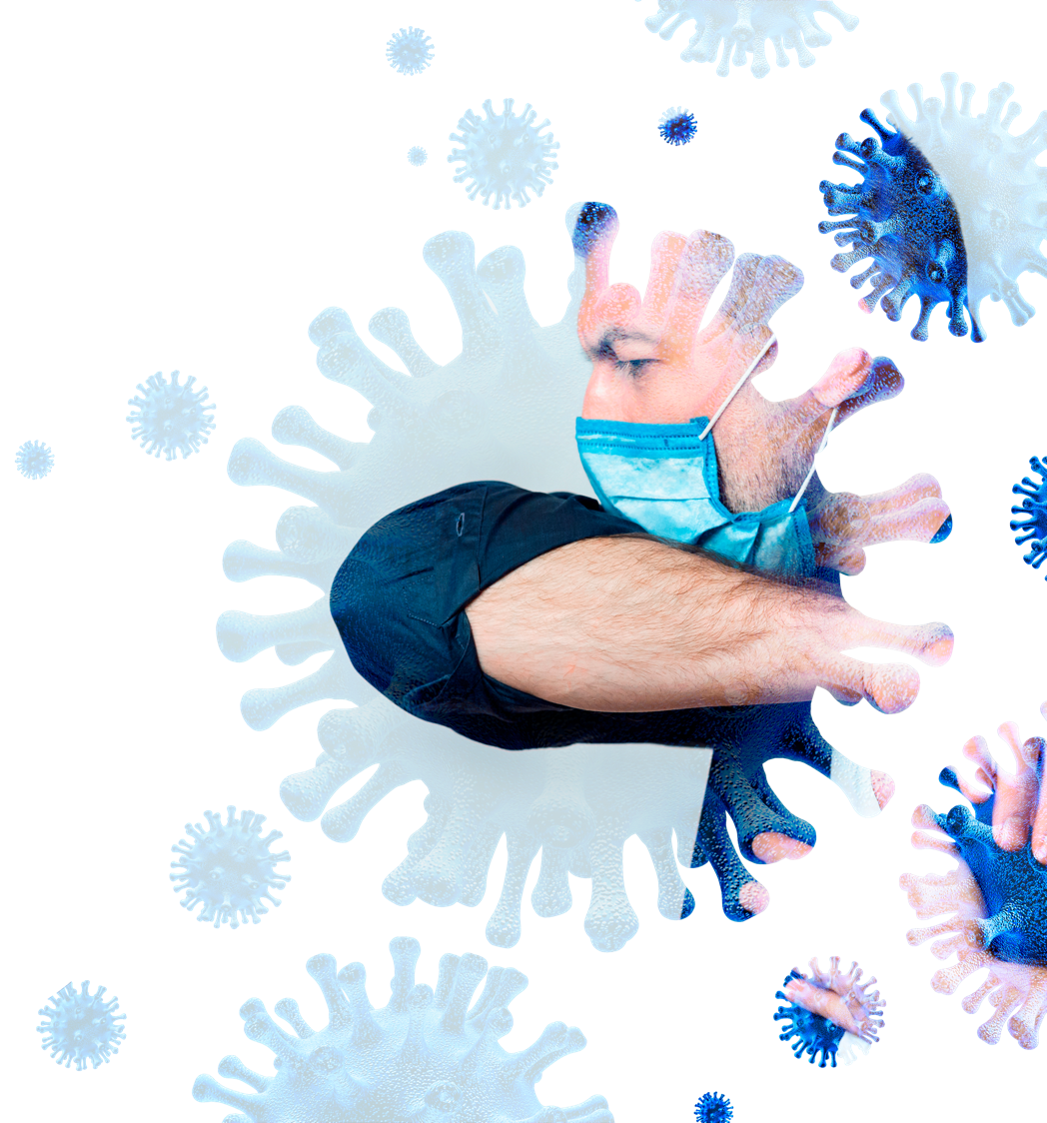
Cough etiquette
Ensure people are aware of the following:
Cough or sneeze into a sleeve, elbow or tissue
Always cover your nose and mouth
Dispose of any tissues properly
Wash your hands with soap and water or hand sanitiser with a minimum 60% alcohol content.

Slide 21
Cleaning
Ensuring that all frequently-touched objects and surfaces are regularly cleaned and disinfected to prevent the spread of COVID-19.

Slide 22
Face coverings
Face coverings are recommended in enclosed places where it is difficult to maintain physical distancing. They are also mandatory on public transport.
Coverings can be made of cloth or other textile and may provide some level of protection against transmission of the virus to other people in close proximity in such situations.
Face coverings will not generally be needed during classroom or workshop activities.
They must not be used as an alternative to any of the precautions outlined in this presentation, e.g. physical distancing, hand washing and respiratory hygiene.

Slide 23
Do’s and Don’ts for apprentices
Do:
✅ Wash your hands properly and often. Hands should be washed:
after coughing or sneezing
before and after eating
before and after preparing food
if you’re in contact with someone who has symptoms
before and after being on public transport
before and after being in a crowd, especially indoors
when entering and leaving buildings
before having a cigarette or vaping
if your hands are dirty
after using the toilet
✅ Clean and disinfect frequently-
touched objects and surfaces.
Don’t:
❌ Touch your eyes, nose, or mouth if your hands are not clean.
❌ Share objects, e.g. bottles, cups, e-cigarettes/cigarettes, mobile phones etc.

Slide 24
Update risk assessments
All risk assessment documentation for workshops and classrooms should be reviewed before colleges reopen.
Ensure this documentation is aligned with both the measures in this presentation and any relevant Scottish Government guidelines.
www.cicvforum.co.uk
24

Slide 25
Sharing
This presentation should be shared with all lecturers and apprentices on a continual basis to ensure all procedures are followed.
Any apprentice not following the rules should be reported to their Training Provider for immediate action.
www.cicvforum.co.uk
25

Slide 26
Please note: The CICV Forum is not liable for the information given in this presentation. Colleges should always consider the most up to date information from the Scottish Government.
info@cicvforum.co.uk / www.cicvforum.co.uk

